Slide 1
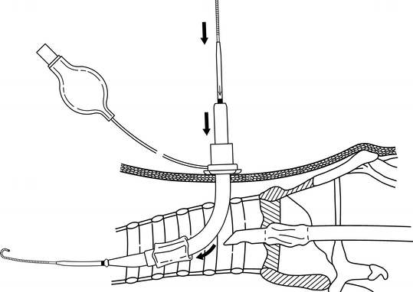
A Simple Trach Exchange
E.O. O’Brien, MD
Anesthesiology and Critical Care Medicine
University of California, San Diego

Slide 2
Two cases with the same problem
#1
64 M s/p heart transplant 13 days ago with persistent respiratory failure, toxic metabolic encephalopathy who had gotten percutaneous tracheostomy with a Shiley on POD #2 uneventfully.
Trach had intermittent obstruction with and heart failure service asked us to exchange the trach for a same size but XLT (longer neck length).
#2
52 M admitted with a Type B aortic dissection s/p emergent TEVAR who had an uneventful placement of a Shiley 8 XLT (OD 13.3 mm) on POD 10. On POD 18, we were asked to exchange the trach for a Shiley 6 (OD 10.8 mm) so that the patient could be fitted for a Passe-Muir valve.

Slide 3
Put it in the hole
Equipment was ready: New trach, airway exchange catheter, Conventional laryngoscope/Video laryngoscope, ETTs, Ambubag and mask, sedatives, paralytics, Bronch tower, New perc trach kit.
Both trachs were well older than 7 days. Track appear mature.
Patient was pre-oxygenated, #1 required no sedation, #2 was given propofol bolus for sedation.
Fiberoptic bronch passed into old track . Position in trachea confirmed.
Airway exchange catheter was placed easily

Slide 4
Seriously, put it in the hole
Old trach removed easily.
New trach inserted over exchange catheter.
New trach will not enter the hole despite repeated attempts.
Patient begins to desaturate.
Attempt to ventilate through the airway exchange catheter, but air is lost through the trach hole.

Slide 5
What would you do?

Slide 6
Technique
Place a needle between ring 1-2 or 2-3..
Enter trachea under bronchoscopic visualization.

Slide 7
Technique
Pass a dilator and trach tube (usually as one apparatus) over the wire and seat the trach.
Remove the wire and dilator and verify trach placement with bronchoscope.

Slide 8
So…What would you do?

Slide 9
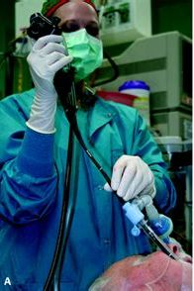
Direct visualization
Both patients were easily re-intubated.
Tube advanced so cuff past trach hole
Bronch passed into ETT.
Bronch and ETT slowly withdrawn so trach hole could be visualized.
Entry site was off midline by approximately 45 degrees.

Slide 10
Sidewall entry

Slide 11
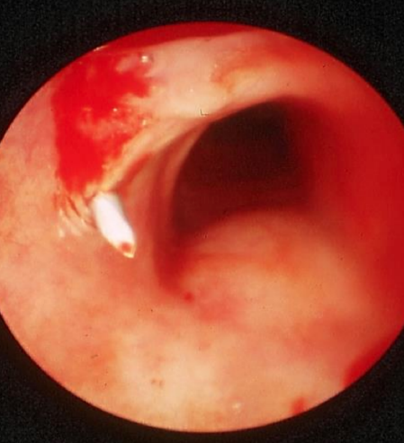
Midline at skin, not at the trachea

Slide 12
A better way
Percutaneous tracheostomy insertion can be way off midline.
Can appear midline at skin, but enter trachea via sidewall.
Best to visualize BEFORE removing trachea.
Easiest to visualize using an LMA (supra-glottic airway).
Pass bronch through the LMA and visualize the trachea during removal and replacement.
Ultrasound may also be able to image trach entry site.

Slide 13
Warning
This doesn’t work in patients after total laryngectomy.
Exchange their tracheostomy tubes with great caution.
Can be helpful after acutely dislodged trach that is hard to replace.
Simple trach exchange can become very complicated very fast.

